Slide 1
ALGORITHMS AND FLOWCHARTS

Slide 2
ALGORITHMS AND FLOWCHARTS
A typical programming task can be divided into two phases:
Problem solving phase
produce an ordered sequence of steps that describe solution of problem
this sequence of steps is called an algorithm
Implementation phase
implement the program in some programming language

Slide 3
Steps in Problem Solving
First produce a general algorithm (one can use pseudocode)
Refine the algorithm successively to get step by step detailed algorithm that is very close to a computer language.
Pseudocode is an artificial and informal language that helps programmers develop algorithms. Pseudocode is very similar to everyday English.

Slide 4
Pseudocode & Algorithm
Example 1: Write an algorithm to determine a student’s final grade and indicate whether it is passing or failing. The final grade is calculated as the average of four marks.

Slide 5
Pseudocode & Algorithm
Pseudocode:
Input a set of 4 marks
Calculate their average by summing and dividing by 4
if average is below 50
Print “FAIL”
else
Print “PASS”

Slide 6
Pseudocode & Algorithm
Detailed Algorithm
Step 1: Input M1,M2,M3,M4
Step 2: GRADE ← (M1+M2+M3+M4)/4
Step 3: if (GRADE < 50) then
Print “FAIL”
else
Print “PASS”
endif

Slide 7
The Flowchart
(Dictionary) A schematic representation of a sequence of operations, as in a manufacturing process or computer program.
(Technical) A graphical representation of the sequence of operations in an information system or program. Information system flowcharts show how data flows from source documents through the computer to final distribution to users. Program flowcharts show the sequence of instructions in a single program or subroutine. Different symbols are used to draw each type of flowchart.

Slide 8
The Flowchart
A Flowchart
shows logic of an algorithm
emphasizes individual steps and their interconnections
e.g. control flow from one action to the next

Slide 9
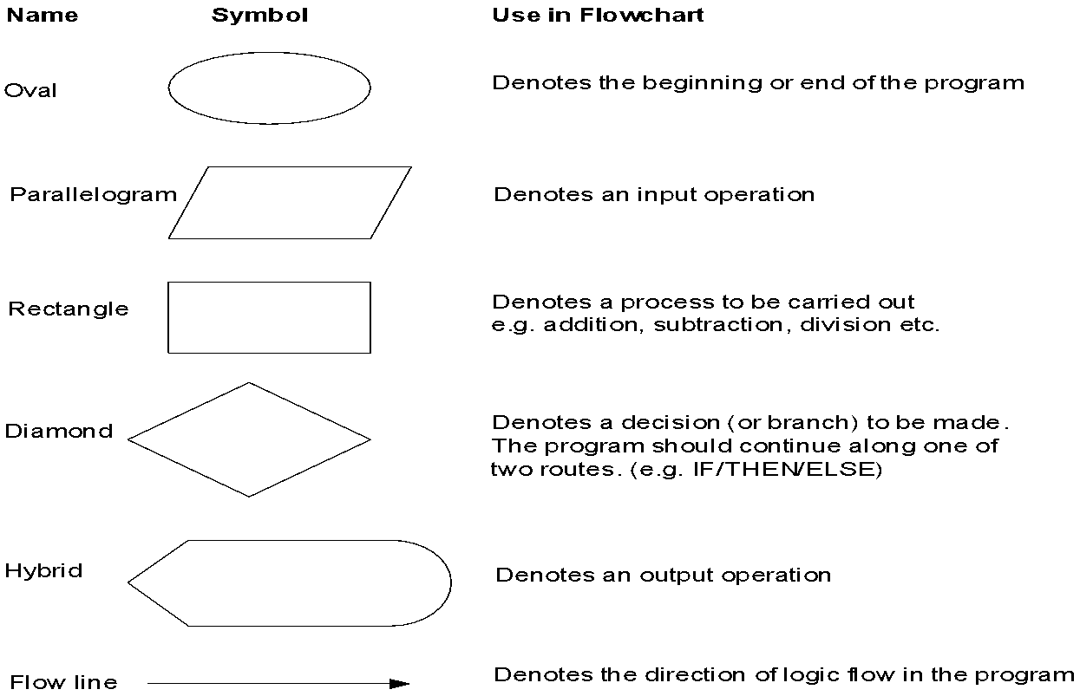
Flowchart Symbols
Basic

Slide 10
Example
START
Step 1: Input M1,M2,M3,M4
Step 2: GRADE ← (M1+M2+M3+M4)/4
Step 3: if (GRADE <50) then
Print “FAIL”
else
Print “PASS”
endif
Input
M1,M2,M3,M4
GRADE←(M1+M2+M3+M4)/4
IS
GRADE<50
N
Y
PRINT
“PASS”
PRINT
“FAIL”
STOP

Slide 11
Example 2
Write an algorithm and draw a flowchart to convert the length in feet to centimeter.
Pseudocode:
Input the length in feet (Lft)
Calculate the length in cm (Lcm) by multiplying LFT with 30
Print length in cm (LCM)

Slide 12
Example 2
Flowchart
Algorithm
Step 1: Input Lft
Step 2: Lcm ← Lft x 30
Step 3: Print Lcm
START
Input
Lft
Lcm ← Lft x 30
Print
Lcm
STOP

Slide 13
Example 3
Write an algorithm and draw a flowchart that will read the two sides of a rectangle and calculate its area.
Pseudocode
Input the width (W) and Length (L) of a rectangle
Calculate the area (A) by multiplying L with W
Print A

Slide 14
Example 3
Algorithm
Step 1: Input W,L
Step 2: A ← L x W
Step 3: Print A
START
Input
W, L
A ← L x W
Print
A
STOP

Slide 15
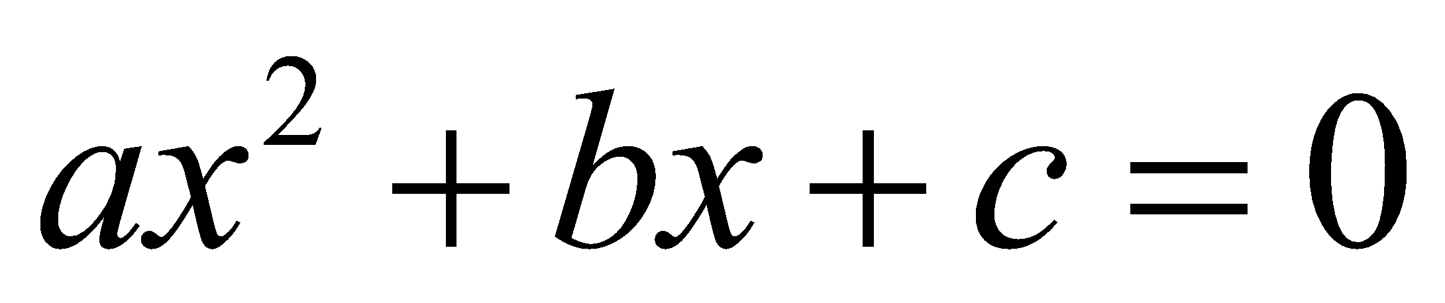
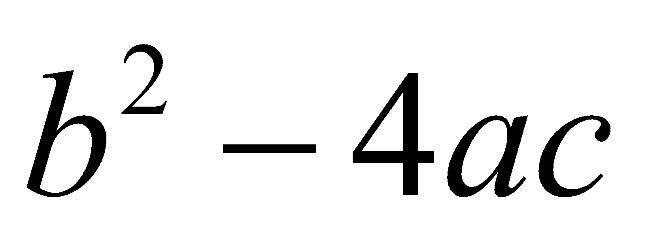
Example 4
Write an algorithm and draw a flowchart that will calculate the roots of a quadratic equation
Hint: d = sqrt ( ), and the roots are: x1 = (–b + d)/2a and x2 = (–b – d)/2a

Slide 16
Example 4
Pseudocode:
Input the coefficients (a, b, c) of the quadratic equation
Calculate d
Calculate x1
Calculate x2
Print x1 and x2

Slide 17
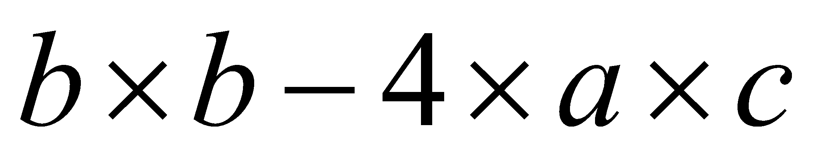
Example 4
START
Algorithm:
Step 1: Input a, b, c
Step 2: d ← sqrt ( )
Step 3: x1 ← (–b + d) / (2 x a)
Step 4: x2 ← (–b – d) / (2 x a)
Step 5: Print x1, x2
Input
a, b, c
d ← sqrt(b x b – 4 x a x c)
x₁ ←(–b + d) / (2 x a)
X₂ ← (–b – d) / (2 x a)
Print
x₁ ,x₂
STOP

Slide 18
DECISION STRUCTURES
The expression A>B is a logical expression
it describes a condition we want to test
if A>B is true (if A is greater than B) we take the action on left
print the value of A
if A>B is false (if A is not greater than B) we take the action on right
print the value of B

Slide 19
DECISION STRUCTURES
is
A>B
Y
N
Print A
Print B

Slide 20
IF–THEN–ELSE STRUCTURE
The structure is as follows
If condition then
true alternative
else
false alternative
endif

Slide 21
IF–THEN–ELSE STRUCTURE
The algorithm for the flowchart is as follows:
If A>B then
print A
else
print B
endif
is
A>B
Y
N
Print A
Print B

Slide 22
Relational Operators
Relational Operators
Operator
Description
>
Greater than
<
Less than
=
Equal to
≥
Greater than or equal to
≤
Less than or equal to
≠
Not equal to

Slide 23
Example 5
Write an algorithm that reads two values, determines the largest value and prints the largest value with an identifying message.
ALGORITHM
Step 1: Input VALUE1, VALUE2
Step 2: if (VALUE1 > VALUE2) then
MAX ← VALUE1
else
MAX ← VALUE2
endif
Step 3: Print “The largest value is”, MAX

Slide 24
Example 5
START
Input
VALUE1,VALUE2
Y
is
VALUE1>VALUE2
N
MAX ← VALUE1
MAX ← VALUE2
Print
“The largest value is”, MAX
STOP

Slide 25
NESTED IFS
One of the alternatives within an IF–THEN–ELSE statement
may involve further IF–THEN–ELSE statement

Slide 26
Example 6
Write an algorithm that reads three numbers and prints the value of the largest number.

Slide 27
Example 6
Step 1: Input N1, N2, N3
Step 2: if (N1>N2) then
if (N1>N3) then
MAX ← N1 [N1>N2, N1>N3]
else
MAX ← N3 [N3>N1>N2]
endif
else
if (N2>N3) then
MAX ← N2 [N2>N1, N2>N3]
else
MAX ← N3 [N3>N2>N1]
endif
endif
Step 3: Print “The largest number is”, MAX

Slide 28
Example 6
Flowchart: Draw the flowchart of the above Algorithm.

Slide 29
Example 7
Write and algorithm and draw a flowchart to
read an employee name (NAME), overtime hours worked (OVERTIME), hours absent (ABSENT) and
determine the bonus payment (PAYMENT).

Slide 30
Example 7
Bonus Schedule
OVERTIME – (2/3)*ABSENT
Bonus Paid
>40 hours
>30 but ≤ 40 hours
>20 but ≤ 30 hours
>10 but ≤ 20 hours
≤ 10 hours
$50
$40
$30
$20
$10

Slide 31
Step 1: Input NAME,OVERTIME,ABSENT
Step 2: if (OVERTIME–(2/3)*ABSENT > 40) then
PAYMENT ← 50
else if (OVERTIME–(2/3)*ABSENT > 30) then
PAYMENT ← 40
else if (OVERTIME–(2/3)*ABSENT > 20) then
PAYMENT ← 30
else if (OVERTIME–(2/3)*ABSENT > 10) then
PAYMENT ←20
else
PAYMENT ← 10
endif
Step 3: Print “Bonus for”, NAME “is $”, PAYMENT

Slide 32
Example 7
Flowchart: Draw the flowchart of the above algorithm?

